Slide 1
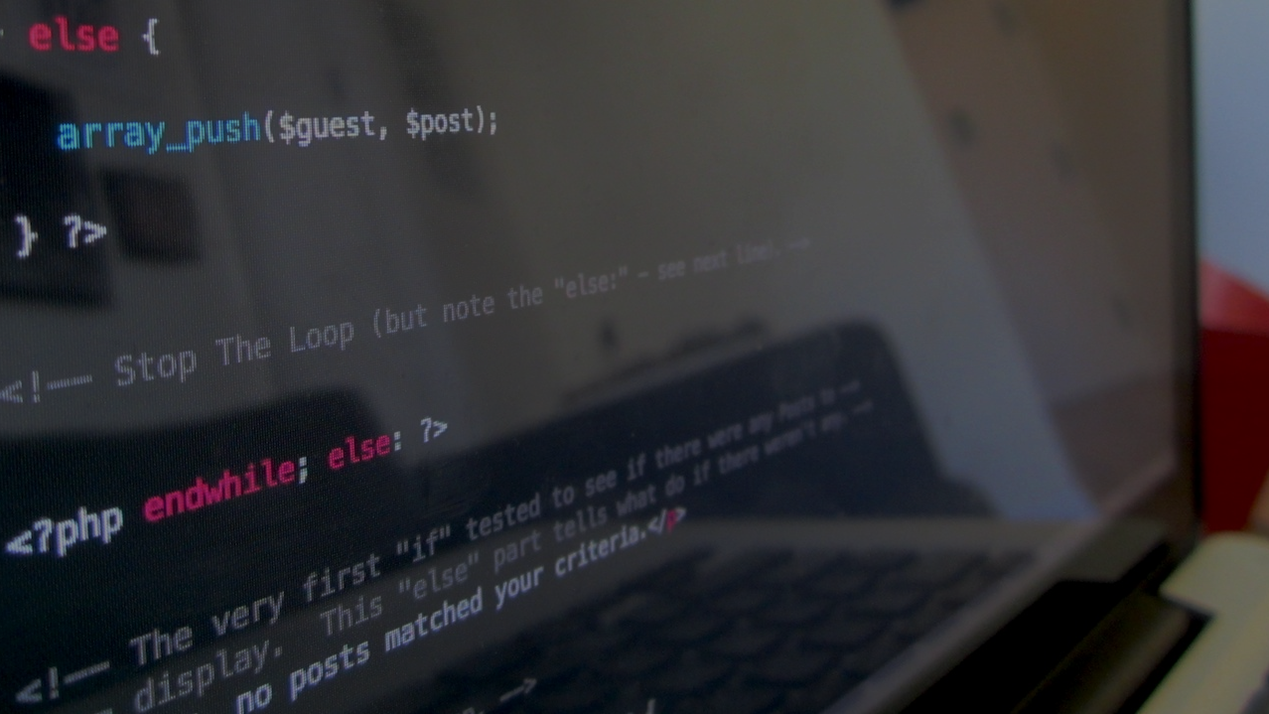

The first Hub for Developers
Testing
Dimitris Deligiorgis

Slide 2
What?
A unit test is code written by a developer that test a small piece of functionality (unit).
“Program testing can be used to show the presence of bugs but never to show their absence!” - Edsger Dijkstra, [1972]

Slide 3
Who & how?
Are written by developers, not by QA engineers
Are released into the code repository, along with the code they test
Unit testing framework is needed
All classes & methods should be tested
All unit tests should pass before committing in the source control repository

Slide 4
Why?
Dramatically decrease the number of defects in the code
Improve design
Are good documentation
Reduce the cost of change
Allow merciless refactoring

Slide 5
Traditional vs Test Driven Development (TDD)
When you do traditional unit testing, you write test after you wrote your code
TDD is a design process, not a testing process
Write unit test before writing code
Fully tested code upfront
Forces you to design your classes correctly
It also forces you to keep it simple stupid
Notes:
Procrastination => δεν μπορείς να το αναβάλεις!

Slide 6
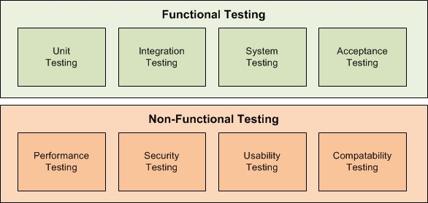
Types
Notes:
Unit – do the parts perform correctly alone
Integration – do the parts perform correctly alone
User Acceptance – does the user meet the end user’s expectations

Slide 7
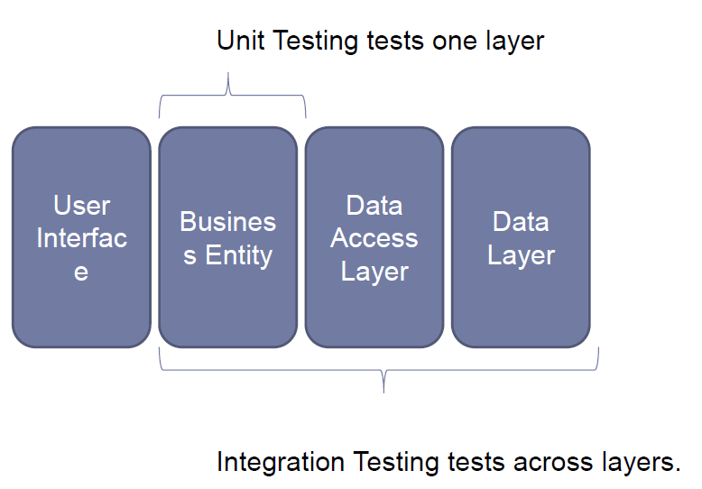
Unit vs Integration Testing

Slide 8
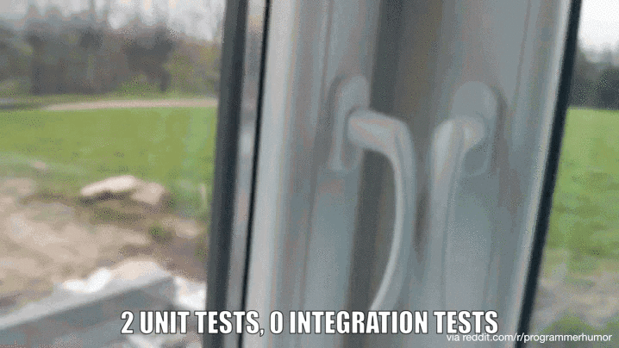
Unit vs Integration Testing Sample (oups!)

Slide 9
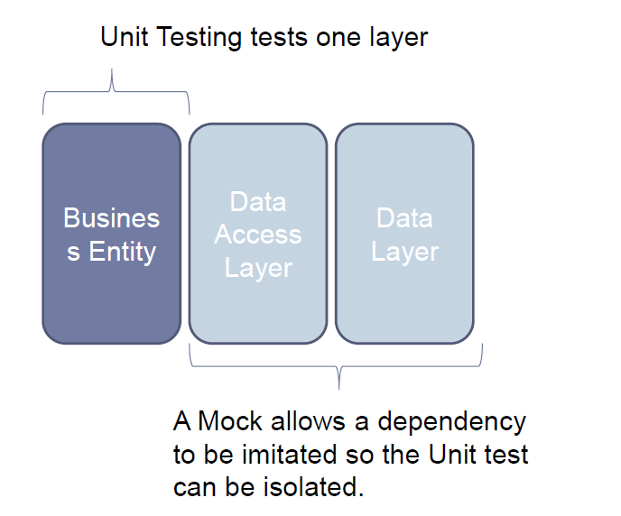
Unit Testing with Mocks

Slide 10
The 3A Pattern
Arrange all necessary preconditions and inputs
Act on the object or method under test
Assert that the expected results have occurred

Slide 11
Best practices
The test name should express a specific requirement that is tested
Expected input or state
Expected result output or state
Name of the tested method
ex. [TestMethod_StateUnderTest_ExpectedBehavior]

Slide 12
When Should a Test be Changed or Removed?
A passing test should never be removed
A passing test should only be changed to make it more readable
When tests don't pass, it usually means there are conflicting requirements

Slide 13
Thank you

